Slide 1
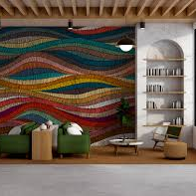
Dynamic Walls: A Wallpaper Application
Name: Abu Saad
Student ID: 30083959

Slide 2

Project Overview
Growing Demand: Users increasingly seek personalized and dynamic wallpaper options for their devices.
Pexels Integration: Utilizes Pexels API for access to high-quality, real-time images.
User-Friendly Design: Features a clean, intuitive interface for easy navigation and wallpaper selection.
Efficient Performance: Implements Glide for fast image loading and effective caching.
Comprehensive Testing: Ensures compatibility and performance across various Android devices.
Introduction
Customizing devices through wallpapers enhances user experience and aesthetics.
Provides an easy-to-use app for changing wallpapers.
Accesses a vast, high-quality wallpaper library in real-time.
Ensures a simple and intuitive experience for all users.
Utilizes efficient image loading and caching techniques (Elgendy et al., 2021).

Slide 3

Project Overview
Growing Demand: Users increasingly seek personalized and dynamic wallpaper options for their devices.
Pexels Integration: Utilizes Pexels API for access to high-quality, real-time images.
User-Friendly Design: Features a clean, intuitive interface for easy navigation and wallpaper selection.
Efficient Performance: Implements Glide for fast image loading and effective caching.
Comprehensive Testing: Ensures compatibility and performance across various Android devices.
Aims and Objectives
Integrate Pexels API: Access a vast library of high-quality wallpapers.
Create User-Friendly Interface: Design an intuitive and easy-to-navigate app.
Enable Wallpaper Switching: Allow users to set wallpapers for home and lock screens.
Optimize Image Loading: Implement efficient loading and caching strategies (Gan and Balakrishnan, 2016).
Conduct Comprehensive Testing: Ensure compatibility and performance across Android devices.

Slide 4
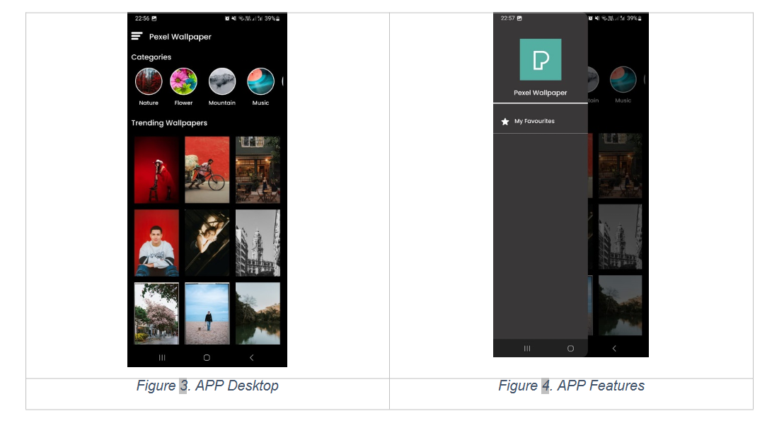
Project Overview
Methodology and design
Growing Demand: Users increasingly seek personalized and dynamic wallpaper options for their devices.
Pexels Integration: Utilizes Pexels API for access to high-quality, real-time images.
User-Friendly Design: Features a clean, intuitive interface for easy navigation and wallpaper selection.
Efficient Performance: Implements Glide for fast image loading and effective caching.
Comprehensive Testing: Ensures compatibility and performance across various Android devices.
Design Approval: Confirm the app design with a clear splash screen.
Splash Screen Creation: Use animated logos and text from Pexels for user engagement.
User Interface Development: Build a simple layout with categories and favorite wallpapers (Elgendy et al., 2021).
Pexels API Integration: Implement the API for accessing high-quality images.

Slide 5
Project Overview
Growing Demand: Users increasingly seek personalized and dynamic wallpaper options for their devices.
Pexels Integration: Utilizes Pexels API for access to high-quality, real-time images.
User-Friendly Design: Features a clean, intuitive interface for easy navigation and wallpaper selection.
Efficient Performance: Implements Glide for fast image loading and effective caching.
Comprehensive Testing: Ensures compatibility and performance across various Android devices.
Challenges faced
Splash Screen Animation Complexity
Ensuring smooth animation without slowing down the app.
API Integration Challenges
Difficulties with incorporating Pexels API for diverse wallpapers.
Search Function Performance
Issues with optimizing search functionality and results (Karjatkar et al., 2024).
Image Loading and Caching
Managing large images without affecting app performance.
Compatibility Across Devices
Ensuring consistent performance on different Android devices.

Slide 6
Project Overview
Growing Demand: Users increasingly seek personalized and dynamic wallpaper options for their devices.
Pexels Integration: Utilizes Pexels API for access to high-quality, real-time images.
User-Friendly Design: Features a clean, intuitive interface for easy navigation and wallpaper selection.
Efficient Performance: Implements Glide for fast image loading and effective caching.
Comprehensive Testing: Ensures compatibility and performance across various Android devices.
How to overcome challenges
Seek Early Feedback: Regularly consult users for their feedback to make adjustments.
Optimize Performance: Use efficient algorithms and tools to improve app speed.
Test on Various Devices: Ensure compatibility by testing on multiple devices and resolutions.
Enhance User Interface: Focus on clear, intuitive design to improve user experience.
Manage Resources Effectively: Implement effective caching to reduce load times and memory use (Gao et al., 2014).

Slide 7
Project Overview
Growing Demand: Users increasingly seek personalized and dynamic wallpaper options for their devices.
Pexels Integration: Utilizes Pexels API for access to high-quality, real-time images.
User-Friendly Design: Features a clean, intuitive interface for easy navigation and wallpaper selection.
Efficient Performance: Implements Glide for fast image loading and effective caching.
Comprehensive Testing: Ensures compatibility and performance across various Android devices.
Results and Discussion
Splash Screen Design Enhanced App Attractiveness.
Simple UI Increased User Engagement and Navigation Ease.
Pexels API Provided High-Quality, Dynamic Wallpaper Options.
Search-Based and Curated Methods Improved User Satisfaction.
Extensive Testing Ensured High App Performance and Compatibility (Philippaerts, Preuveneers and Joosen, 2022).

Slide 8

Project Overview
Growing Demand: Users increasingly seek personalized and dynamic wallpaper options for their devices.
Pexels Integration: Utilizes Pexels API for access to high-quality, real-time images.
User-Friendly Design: Features a clean, intuitive interface for easy navigation and wallpaper selection.
Efficient Performance: Implements Glide for fast image loading and effective caching.
Comprehensive Testing: Ensures compatibility and performance across various Android devices.
Conclusion
The app successfully integrates diverse wallpaper options via Pexels API.
Retrofit enhanced performance, providing smooth, efficient API interactions.
The simple UI design improved overall user experience and satisfaction.
Thorough testing ensured high compatibility, performance, and user approval (Kopsiaftis et al., 2021).
Future updates should include advanced search, image editing, and social sharing.

Slide 9
Project Overview
Growing Demand: Users increasingly seek personalized and dynamic wallpaper options for their devices.
Pexels Integration: Utilizes Pexels API for access to high-quality, real-time images.
User-Friendly Design: Features a clean, intuitive interface for easy navigation and wallpaper selection.
Efficient Performance: Implements Glide for fast image loading and effective caching.
Comprehensive Testing: Ensures compatibility and performance across various Android devices.
References
Elgendy, I.A., Zhang, W.-Z., Liu, C.-Y. and Hsu, C.-H., 2021. An Efficient and Secured Framework for Mobile Cloud Computing. IEEE Transactions on Cloud Computing [Online], 9(1), pp.79–87. Available from: https://doi.org/10.1109/tcc.2018.2847347.
Gan, C.L. and Balakrishnan, V., 2016. An Empirical Study of Factors Affecting Mobile Wireless Technology Adoption for Promoting Interactive Lectures in Higher Education. The International Review of Research in Open and Distributed Learning [Online], 17(1). Available from: https://doi.org/10.19173/irrodl.v17i1.2111.
Gao, J., Bai, X., Tsai, W.-T. and Uehara, T., 2014. Mobile Application Testing: A Tutorial. Computer [Online], 47(2), pp.46–55. Available from: https://doi.org/10.1109/mc.2013.445.
Karjatkar, S. et al. (2024) 'AN EMPIRICAL STUDY OF DEVELOPING ANDRIOD APPLICATIONS,' International Research Journal of Modernization in Engineering Technology and Science [Preprint]. https://doi.org/10.56726/irjmets51243.
Kopsiaftis, G. et al. (2021) 'Application Programming Interface for a Customer Experience Analysis Tool,' in Frontiers in artificial intelligence and applications. https://doi.org/10.3233/faia210092.
Philippaerts, P., Preuveneers, D. and Joosen, W. (2022) 'OAuch: Exploring Security Compliance in the OAuth 2.0 Ecosystem,' emanticscholar.org [Preprint]. https://doi.org/10.1145/3545948.3545955.
Github link for project:
https://github.com/abusaad59/Pexel-Wallpaper.git

